Slide 1
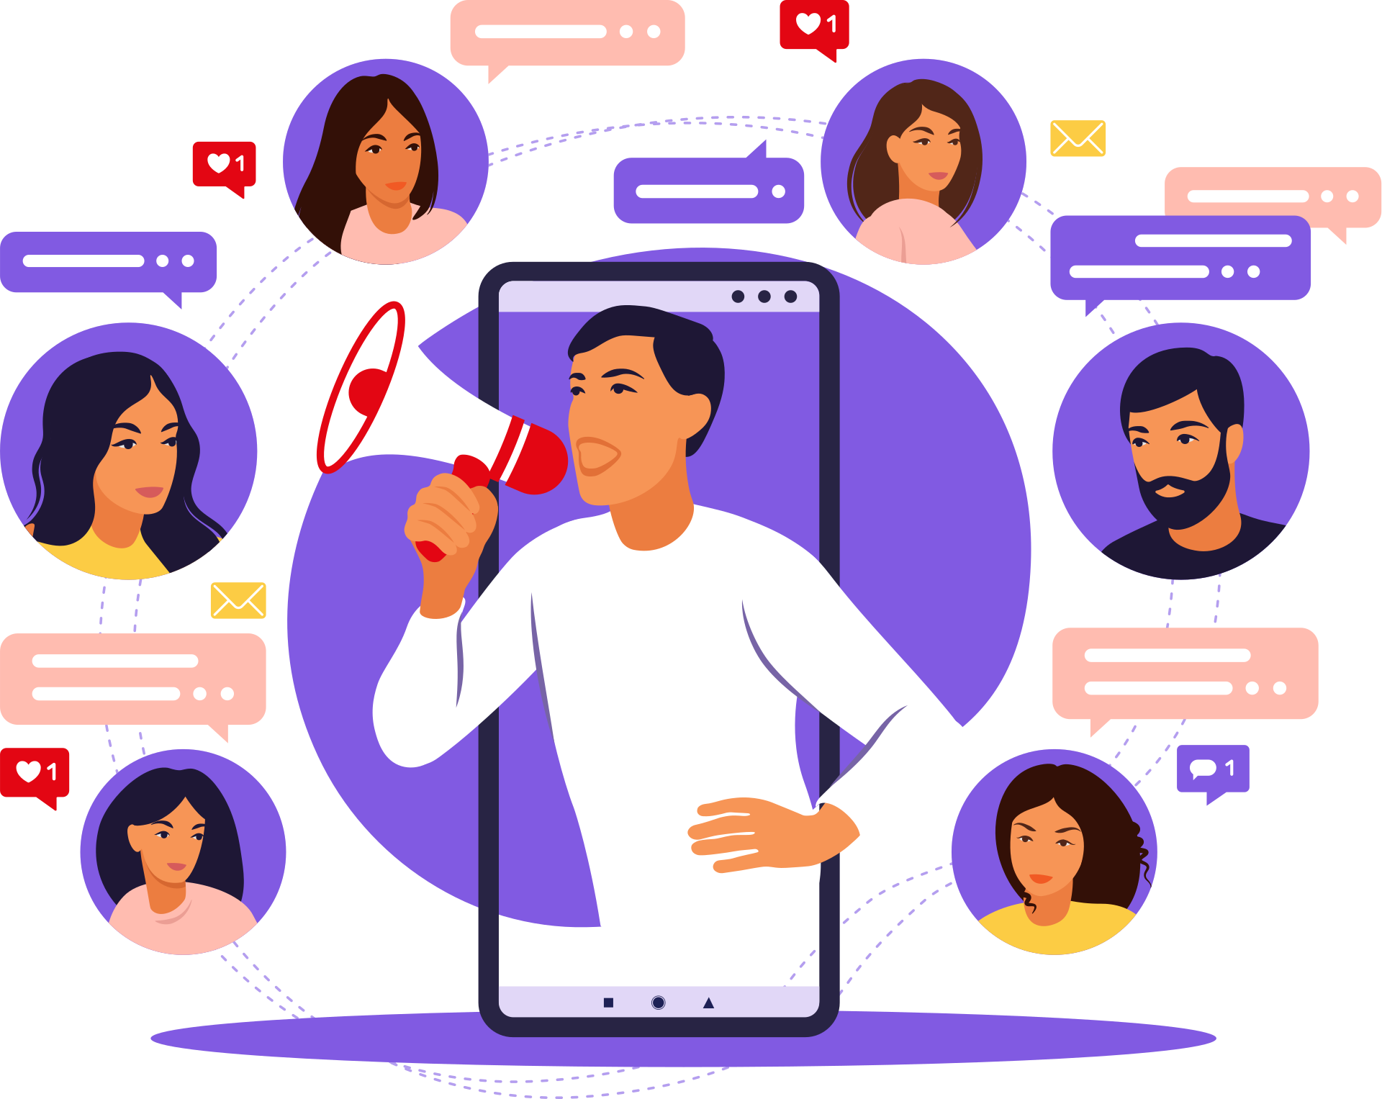
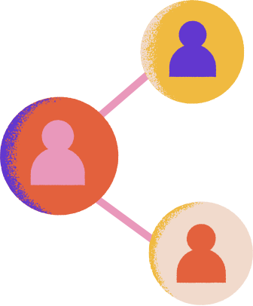
FIND YOUR AUDIENCE WITH
MediAtryX
MAX MARKETING SOLUTIONS

Slide 2
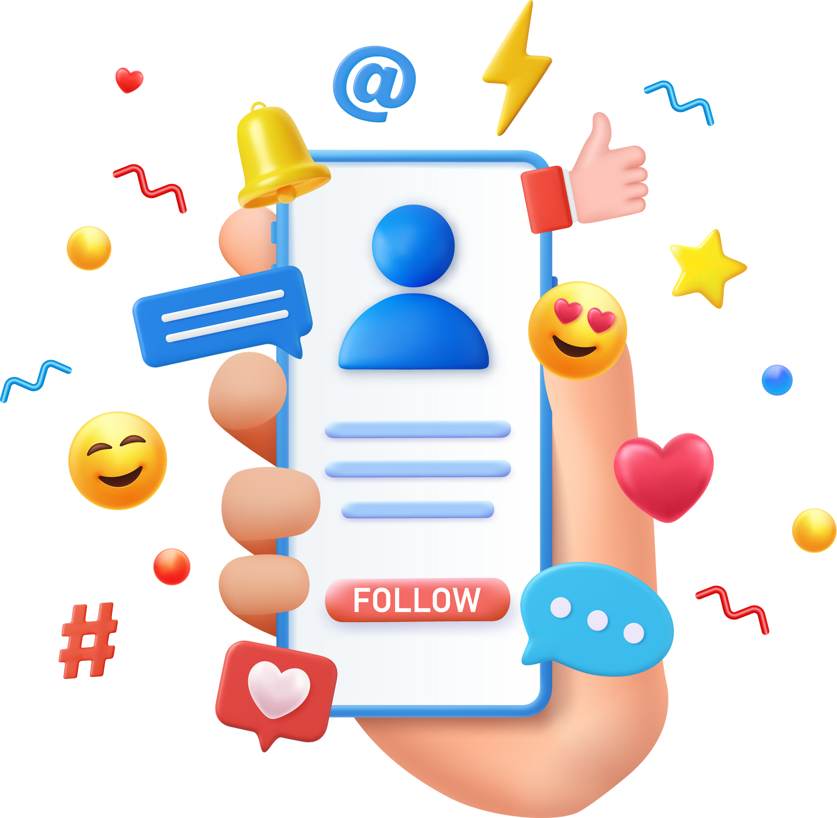
Who are we?
Mediatryx is a leading media solutions company specializing in
advertising
social media marketing (SMM)
outdoor advertising
WhatsApp and Telegram marketing
paid ads
influencer marketing
research analyst-based report generation
broker coverage
e-media printing
news channel coverage.

Slide 3
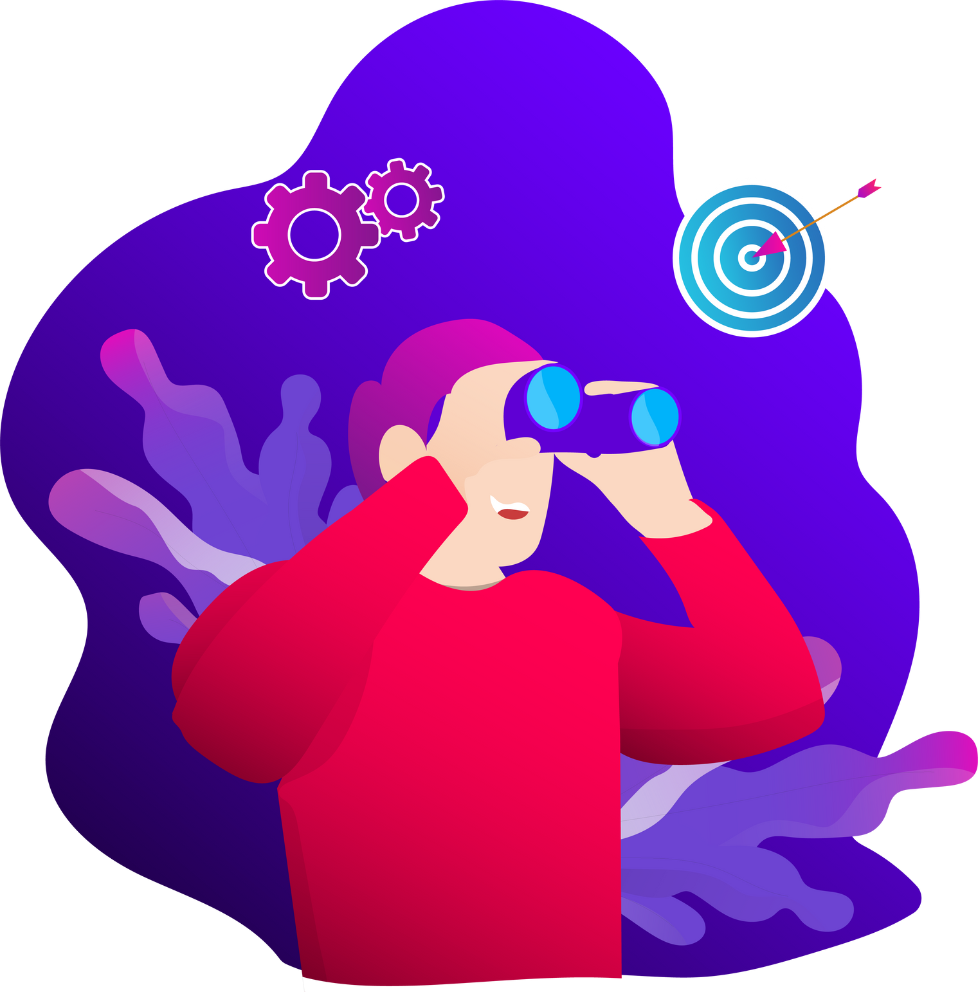
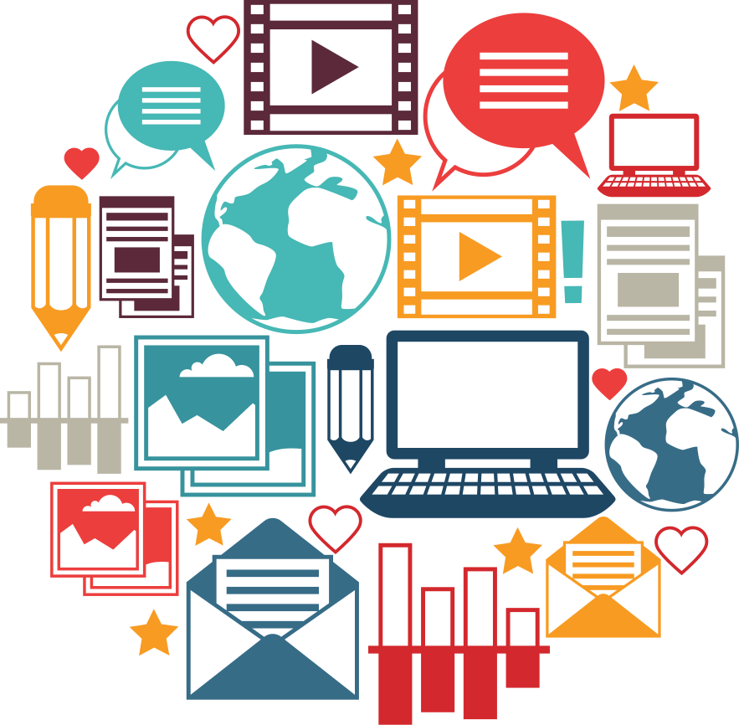
Our Mission
To provide end-to-end services for all your Investor Relations (IR), Public Relations (PR), and investment-related activities, ensuring compliance with SEBI guidelines.

Slide 4

Our Expertise
Advertising
Influencer Marketing
Social Media Marketing
Research Report
Outdoor Ads
Broker Coverage
Wapp & Tele
E-Media Printing
Paid Ads
News Prime Time

Slide 5





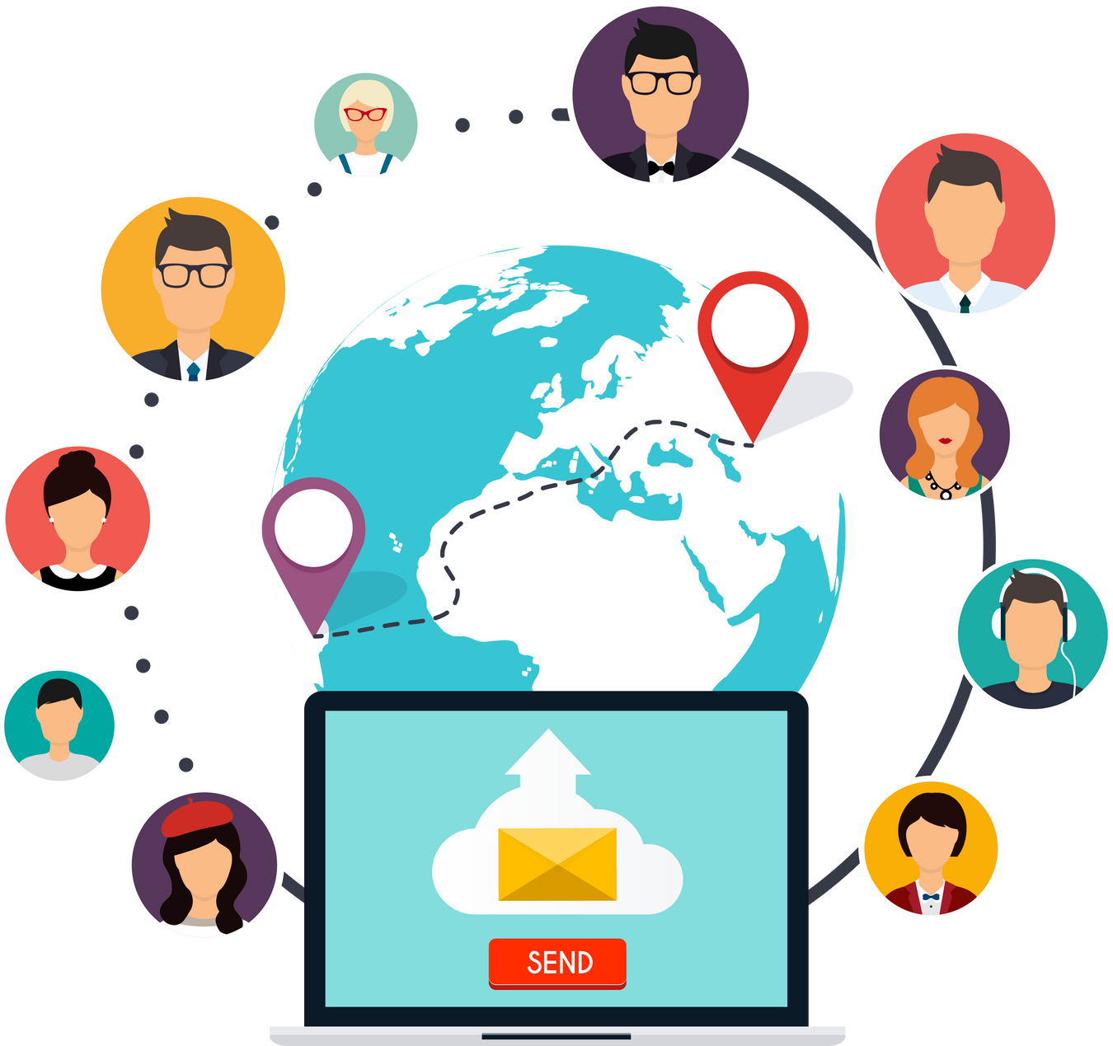
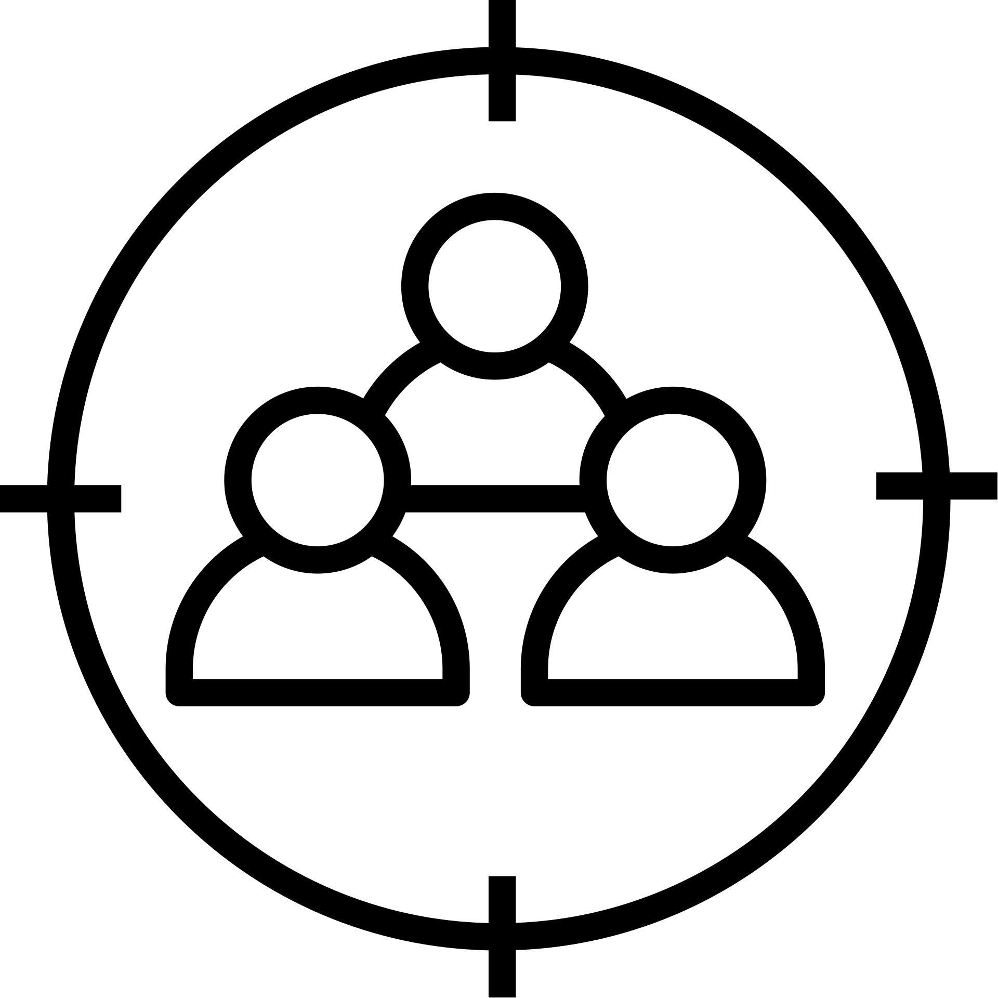




Understanding Digital Marketing
Defining digital marketing as the utilization of digital technology to promote products or services. Highlighting its broad scope, encompassing online channels such as-
websites
social media
search engines
email
mobile applications.
Wider audience reach
Cost efficiency
Measurable results
Accurate targeting
Enhanced interactive interactions

Slide 6

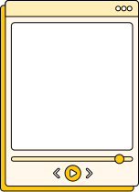



Market Research
1.
2.
TARGET AUDIENCE
COMPETITIVE BENCHMARKING
We identify and analyze your ideal customers, understanding their demographics, behaviors, preferences, and needs. This helps us tailor marketing strategies to effectively reach and engage your audience.
We assess your competitors’ strengths and weaknesses, examining their strategies and performance. This enables us to identify opportunities and threats, positioning your brand strategically in the market.

Slide 7
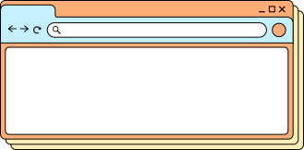

Your website is often the first impression potential customers have of your business. Our web design services focus on creating visually appealing, user-friendly, and responsive websites that reflect your brand and engage your audience. We prioritize functionality and aesthetics, ensuring that your website not only looks great but also provides a seamless user experience. Our goal is to convert visitors into customers through effective design and intuitive navigation.
Web Design

Slide 8
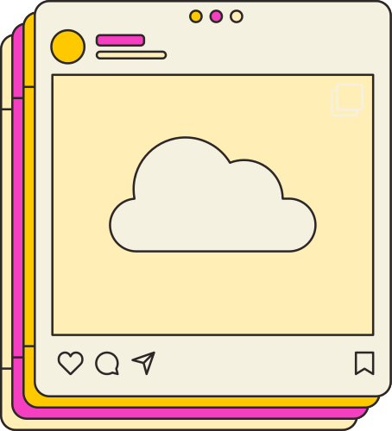

SEO Optimization
Search Engine Optimization (SEO) is at the core of our digital marketing strategy. Our SEO services aim to increase your website’s visibility on search engines, driving organic traffic and improving your online presence. We conduct thorough keyword research, optimize your website’s content and structure, and implement effective link-building strategies. Our goal is to help you rank higher on search engines, attract more visitors, and convert them into loyal customers.

Slide 9
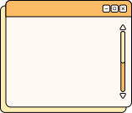
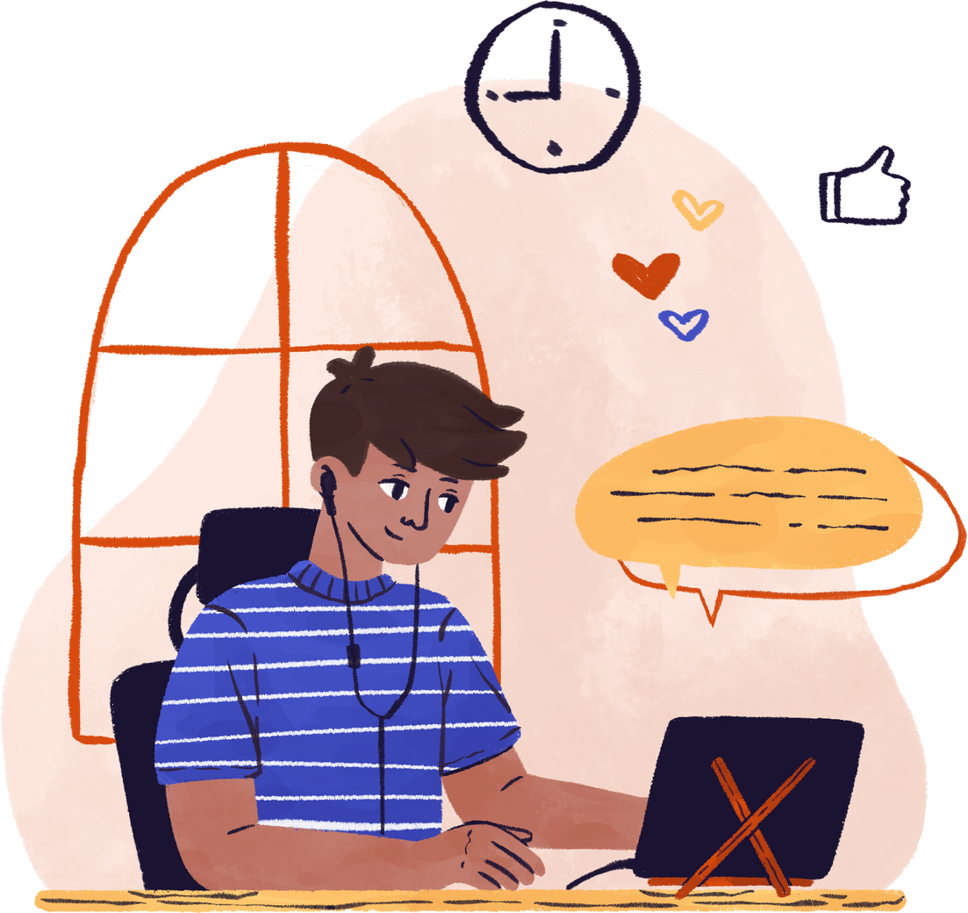
Content Creation
Compelling content is key to engaging your audience and driving conversions. Our content creation services include crafting high-quality blog posts, articles, social media updates, and multimedia content that resonate with your target audience. We focus on creating content that not only informs and entertains but also aligns with your brand’s voice and objectives. By consistently delivering valuable content, we help you build trust and authority in your industry.

Slide 10



Social Media
Social media connects you with your audience and builds brand awareness. Our services include strategy development, content creation, community management, and paid advertising tailored to each platform. We ensure your brand message is consistent and engaging, maximizing reach and impact through analytics and audience interaction.

Slide 11





Consistency
Responsive Interaction
Content
Social Media Design
Strategy
Engagement
Planning
Interaction
Visuals
Graphics
User Feedback

Slide 12
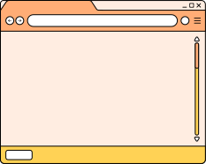
PPC Advertising
Pay-Per-Click (PPC) advertising is an effective way to drive targeted traffic to your website. Our PPC services include creating and managing campaigns on platforms like social media. We focus on optimizing your ad spend to achieve the highest return on investment (ROI). Our team continuously monitors and adjusts your campaigns to ensure optimal performance, helping you reach your target audience and achieve your marketing goals.

Slide 13
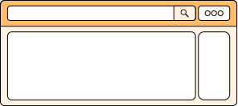
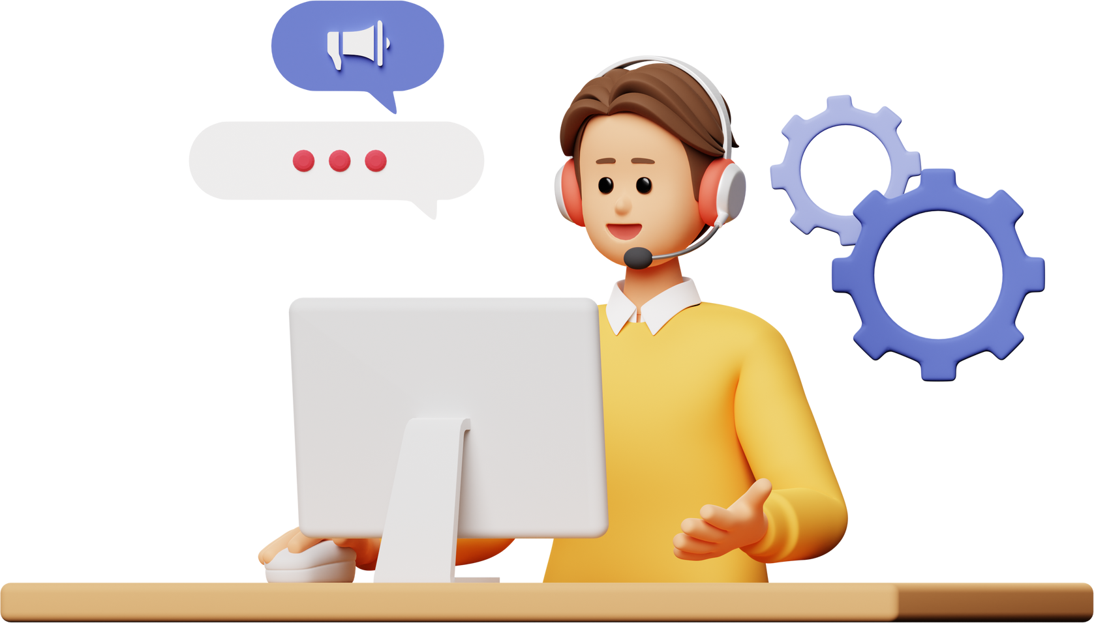
Email Marketing
What’s inside?
Email marketing nurtures leads and engages your audience. Our services cover strategy, list management, and personalized campaigns. We create automated email sequences to deliver timely messages, analyze performance, and optimize content to build strong subscriber relationships and drive conversions.

Slide 14
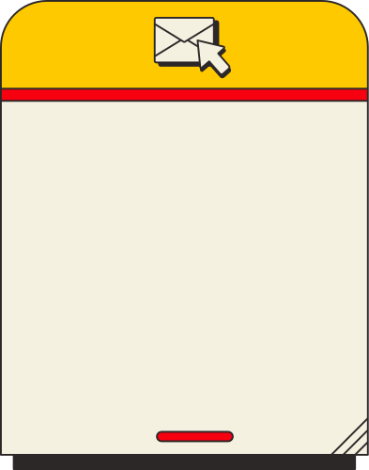

Data is at the heart of our digital marketing strategies. Our analytics and reporting services provide you with detailed insights into your marketing performance. We track key metrics, analyze user behavior, and measure the effectiveness of your campaigns. By translating data into actionable insights, we help you make informed decisions and continuously optimize your marketing efforts to achieve better results.
Analytics & Reporting

Slide 15

We turn visitors into customers by improving your website's user experience. Our conversion optimization services include analyzing user behavior, identifying barriers, and implementing strategies like A/B testing to enhance site performance and increase conversion rates.
Conversion Optimization

Slide 16
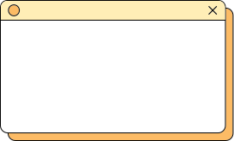
Thank
You!
hello@mediatryx.com
www.mediatryx.com

Slide 17
www.mediatryx.com
MediatryX
X marks the spot for all media needs

Slide 18

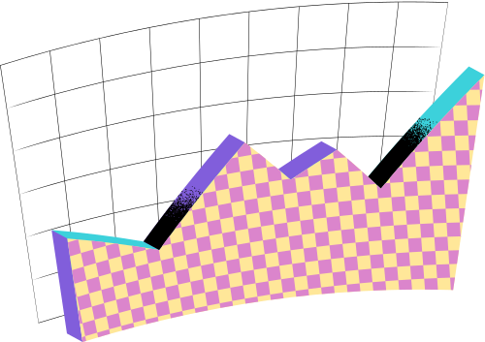
Introduction
Who are we?
Mediatryx is a leading media solutions company specializing in advertising, social media marketing (SMM), outdoor advertising, WhatsApp and Telegram marketing, paid ads, influencer marketing, research analyst-based report generation, broker coverage, e-media printing, and news channel coverage.

Slide 19
Introduction
Our Mission!
To provide end-to-end services for all your Investor Relations (IR), Public Relations (PR), and investment-related activities, ensuring compliance with SEBI guidelines.

Slide 20


Our Services
Advertising
Influencer Marketing
Social media marketing (SMM)
RA based Report
Outdoor Advertising
Broker Coverage
Wapp & Tele
E-media Printing
Paid ads
News Channel Coverage

Slide 21
Understanding Digital Marketing
Defining digital marketing as the utilization of digital technology to promote products or services. Highlighting its broad scope, encompassing online channels such as: websites, social media, search engines, email, and mobile applications.

Slide 22

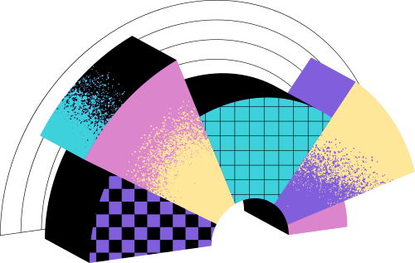
Benefits of Digital Marketing
Wider audience reach
Accurate targeting
Enhanced interactive interactions
Cost efficiency
Measurable results

Slide 23

Main Channels of Digital Marketing
01
Website and Search Engine Optimization (SEO)
04
Content Marketing
02
Social Media Marketing (SMM)
05
Pay-Per-Click (PPC)
03
06
Advertising Influencer Marketing
Email Marketing

Slide 24





Website and SEO
The importance of having a well-designed website.
The role of SEO in optimizing websites for:
Search engines
Increasing visibility
Enhancing Organic Traffic

Slide 25


Social Media Marketing (SMM)
The appeal of social media platforms creating engaging content
Two-way communication Utilizing analytics for better outcomes

Slide 26
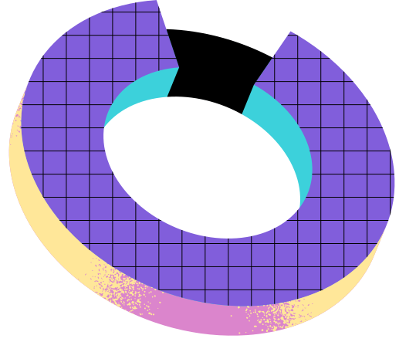
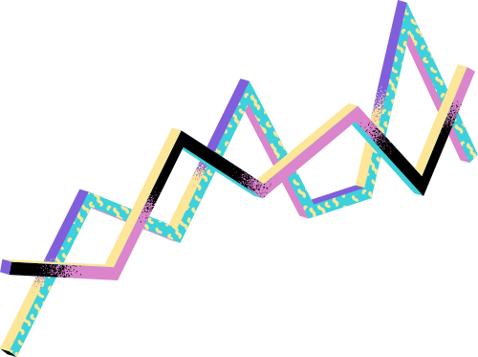

Effectiveness of email marketing
Building an email list
Creating personalized and targeted campaigns
Email Marketing
Analyzing email metrics

Slide 27

Content Marketing
The significance of content marketing
Building brand authority
Providing valuable information
Creating and distributing relevant and engaging content

Slide 28

Pay-Per-Click (PPC) Advertising
The concept of PPC-based advertising
Campaign setup
Generating immediate and targeted traffic
Keyword optimization
Advertising platforms
Performance monitoring

Slide 29

The increasing influence of influencers
Collaborating with relevant influencers
Reaching and engaging with specific target audiences
Influencer Marketing
The importance of authenticity and long-term relationships

Slide 30
Mangalam Alloys Limited:
Challenge: Enhance market visibility and attract potential investors.
Solution: Implemented a comprehensive media strategy, including targeted advertising and influencer partnerships.
Result: Significant increase in brand recognition and investor engagement.
Shree Venkatesh Refineries Ltd:
Challenge: Boost brand awareness in a competitive market.
Solution: Executed a robust SMM campaign coupled with outdoor advertising.
Result: Notable growth in market share and customer base.
IGCIL Rights Issue:
Objective: Facilitate a successful rights issue to raise capital.
Approach: Provided end-to-end support, including research reports, broker coverage, and media outreach.
Outcome: Achieved full subscription, reflecting investor confidence.
Lasa Supergenerics Ltd:
Initiative: Assisting in their upcoming rights issue and warrant issuance.
Strategy: Comprehensive media campaign to inform and attract potential investors.
AMKAY Products:
Plan: Launching a brand revitalization campaign to enhance market presence.
Tactics: Integrated marketing approach combining digital and traditional media.
Clients

Slide 31
Expertise & Affordability
We at Mediatryx bring along a 35 years worth experienced team of more than 100 contributors who have significantly managed companies and have scaled them from 1X to 500X. The best part of assciating with us is the affodability of services at unmatched prices
Compliance and Ethics
SEBI Guidelines Adherence: We strictly follow SEBI norms to ensure ethical and transparent operations.
Commitment to Integrity: Upholding the highest standards in all our services to build trust with our clients and stakeholders.
Why Choose Mediatryx?
Comprehensive Solutions: A one-stop destination for all your IR/PR and investment-related needs.
Proven Expertise: Demonstrated success across various industries.
Client-Centric Approach: Tailored strategies to meet your unique requirements.
Ethical Practices: Strict adherence to regulatory guidelines and ethical standards.

Slide 32



MEDIATRYX
Thank You
Contact
marketing@mediatryx.com

